Slide 1
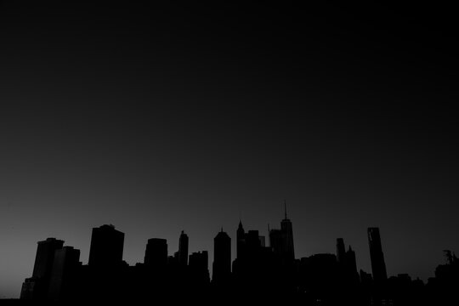

EXPLORING ALGORITHMS FOR MITIGATING BLACKOUT THROUGH BROWNOUT

Slide 2
Issues Existing in Power Distribution
Unpredictable Demand- A rapid rise in power consumption as compared to power generation is being observed in present times.
Frequent power outages- Utilities mostly in developing nations, adopt a naive approach of reducing the demand by rolling blackouts.
However, this approach leads to user inconvenience.
Dependence on Non renewable resources-To meet the required power demand during hours of peak consumption power is generated from non-renewable resources like fossil fuels.
Lack of infrastructure-Many developing countries do not have infrastructure to satisfy these rising demands.

Slide 3

Blackout
A blackout is a total crash of the power grid due to an imbalance between power generation and power consumption.
A blackout is also known as loss of electricity or power outage.

Slide 4
Problems caused by blackouts
Blackout leads to –
Heavy economic losses.
Power system equipment damage.
Wide effect on livelihood. This is so because the living is fully dependent on reliable and quality power system.

Slide 5
Approaches Previously used for mitigating Blackout?
Load shifting.
Using uninterrupted power supply (UPS) to store energy during period of less demand and using it during peak demand hours.
Deactivating few micro-services.
People have used voltage reduction in the past, but using voltage reduction which may lead to damage to appliances and it may lead to damage to circuit breakers.
Thus, we propose a more pragmatic solution of brownout which involves fair allocation of power limits to the consumers.

Slide 6
Brownout
A brownout is like a blackout just not as bad.
A brownout is based on power consumption control.
Where an electrical blackout means a loss of electricity, a brownout is a reduction in power.
Brownout is the process of modifying blackouts with the help of DSM to explore algorithms which can provide the most efficient power distribution.
In our implementation of Brownout we try to provide all user with some Power threshold. Where threshold is the maximum power limit.

Slide 7
Why Brownout?
To reduce the inconvenience to users during blackouts.
To reduce starvation among consumers.
Chances of appliances being compromised is low as comparison to voltage reduction research.
One of the need of implementation of brownout is to ensure that consumer get some amount of power instead of total power failure which help in providing fairness among users in both commercial or residential neighborhood.

Slide 8
Aim
To ensure the following constraints are satisfied:
Fairness in distribution: A fair and just power distribution system should be designed to distribute power without bias, ensuring that all consumers, regardless of their location, socio-economic status, or other demographic factors, have access to reliable and affordable power.
Reduction in violation: Since it will defeat the purpose of brownout where power consumption should be reduced to reduce the burden on electric grid.

Slide 9
Our Contribution
• Developing different power threshold algorithms for practical implementation of brownout. These ensure reduced violation and fairness in allocation using different criteria.
• The hybrid algorithm makes use of multiple fairness heuristic so that starvation of certain consumers for a set of approaches can be avoided; it also ensures minimum violation across the neighbourhood.
• Exhaustive testing and evaluation on on real world datasets of three regions. The impressive results thus obtained convince about the effectivenes of the developed approach.

Slide 10
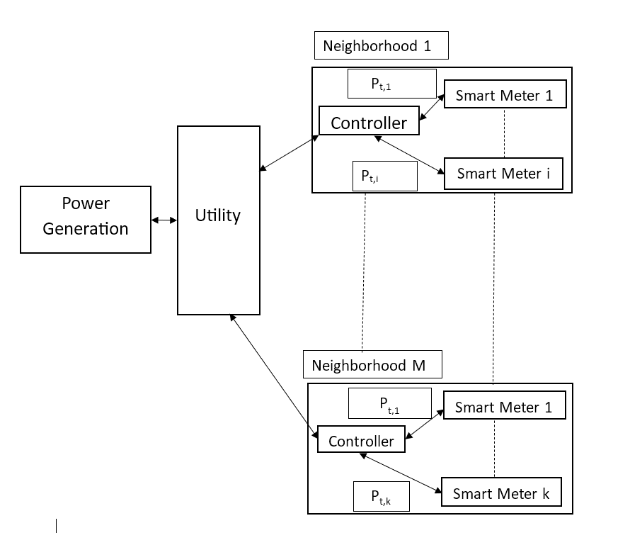
Architecture

Slide 11
Smartmeter-> Measures aggregated power consumption at periodic intervals and this data is sent to controller of neighborhood.
Smartmeter-> Measures aggregated power consumption at periodic intervals and this data is sent to controller of neighborhood.
Controller-> Controller is responsible for implementing novel threshold algorithms for each slot, with the help of data from smartmeter controller can
(a) track the consumers that are violating the thresholds
(b) incorporate the changes in the power consumption behaviour of different consumers while allocating threshold.
Utility->Checks and commands controller for better planning and generation.
Power-> Power generated from mostly non-renewable resources

Slide 12
Dataset
We have used time series real world datasets of 3 different cities named Austin, California and New York.
These datasets have been provided to us by PECAN STREET Incorporation.
On their website we obtained the required datasets for Energy based research in the Dataport section of their website. PECAN STREET Incorporation are the owners of these datasets and they have agreed to provide us these for them to be used for research purpose only.
We plot some attributes to see the data values and variations. Here we have a plot for using 5 attributes-grid(power consumption), air1(air conditioner),dishwasher1(dishwasher), furnace1 and localminute as x-axis.

Slide 13
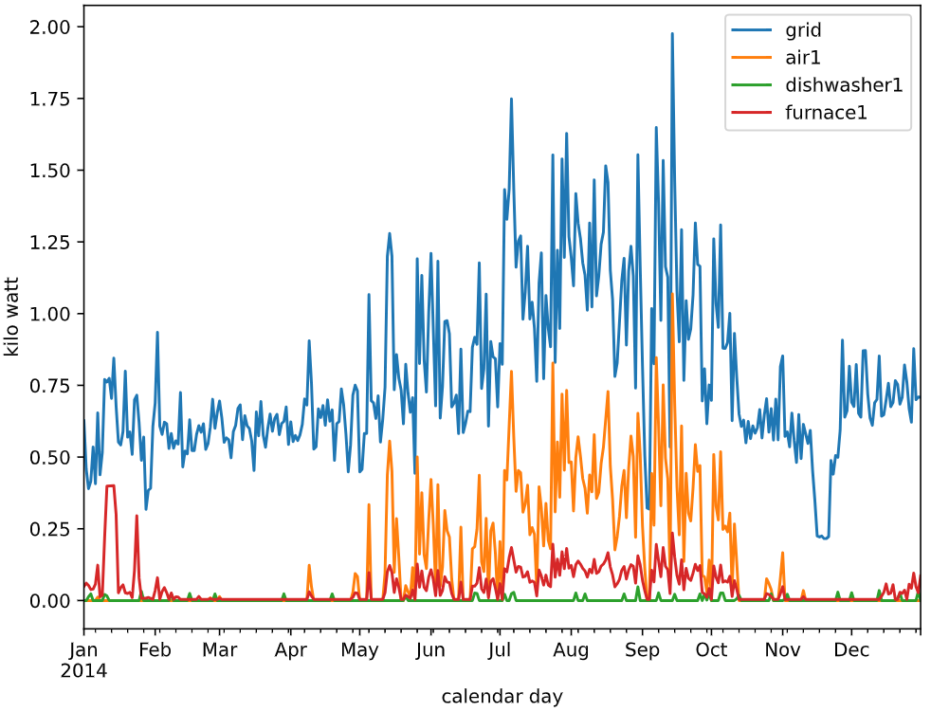
We plot some attributes to see the data values and variations.

Slide 14
Different algorithms used for distribution are as follows :
1. Equal Distribution: This algorithm equally distributes the utility specified threshold power among users in a neighborhood, in a given slot.
Consider a dummy dataset of 3 houses with following power consumption:
house1 – 30kw, house2 – 40kw, and house3 – 50k, thus their total power consumption is 120kw. Assuming that utility impose a threshold of 90kw on all these consumers.
So according to equal distribution threshold for each house is allocated as 90/3 = 30kw. Now if in a case an appliance in all houses require 30kw then there will be starvation for house2 and house3. We can observe that for each time slot the power threshold is divided equally as local threshold.
Advantage- Every user gets some power threshold to operate some devices.
Disadvantage- Starvation for consumers having higher power consumption requirements.
In addition, it leads to wastage of power threshold for consumers with low consumption.

Slide 15
2. Proportionate distribution: This algorithm, distributes power threshold based on the ratio of power consumption of each consumer to the total power consumption of the neighborhood.
Consider a dummy dataset of 3 houses with following power consumption house1 – 30kw, house2 – 40kw, house3 – 50k, so total power consumption=120kw. Assuming that utility impose a threshold of 30kw on all these consumers. So according to proportionate distribution threshold for each house is allocated are as follows-
House1- (30/120)*30=7.5kw, House2- (40/120)*30=10kw, House3-(50/120)*30=12.5kw
Advantage- Users gets power threshold proportionate to their power consumption needs.
Disadvantage- Starvation of users. If a consumer with minimal appliances consumes higher power as compared to other careful consumers, this algorithm will encourage such behaviour by allocating a relatively higher power threshold leading to more wastage of power.

Slide 16
3. Consumer Usage Distribution: This algorithm is used to assign local threshold to each consumer based on ratings. A consumer’s rating is calculated by dividing the power consumption in the previous slot by the maximum power that can be consumed by all appliances in that slot. This ratio is then subtracted from 1 to get the ratings.
A higher rating is indicated by a lower ratio. We have found out the maximum power that can be consumed by each house and divided it to its value at every particular time slot to get a ratio then we have divided it by the summation of all ratio to get normalized ratings. As we have said the lower the ratio higher the ratings hence inversely proportionate result is obtained. Example if a user did not use his home appliances at its full capacity and at has lower power usage thus he has gets higher rating and then higher power is as well as power is allocated to him thus it can be seen both as advantage and disadvantage if he needs more power in next time slot he can get it if he does not then it can lead to waste of energy.
Disadvantage- The only disadvantage is that if at a particular timeslot due to consumer rating if a user gets more local power threshold due to its old consumer rating than required then it may lead to waste of power threshold.

Slide 17
4. Round Robin with equal distribution: This algorithm distributes local thresholds equally in a cyclic manner like in a round robin algorithm. But we give priority to maximum house in each time slot column wise and move cyclically time slot wise.
The main logic behind this algorithm is to fulfill the power requirement of consumer with maximum requirement then repeat this process in a cyclic manner in a round robin manner. So that load decreases gradually.
Hence in every cycle we distribute the power according to maximum among every house and the residual power is distributed among other houses equally.
Advantage- In every time slot the house selected gets the maximum power threshold. And the residual power is equally distributed.
Disadvantage- As with each time slot the residual time slot decreases and it is associated with equal distribution it can lead to starvation for consumers with higher power consumption.

Slide 18
5. Round Robin with proportionate distribution: This algorithm distributes local thresholds proportionally in a cyclic manner like in a round robin algorithm. But we give priority to maximum house in each time slot column wise and move cyclically time slot wise. The main logic behind this algorithm is to fulfill the power requirement of consumer with maximum requirement then repeat this process in a cyclic manner in a round robin manner. So that load decreases gradually.
Hence in every cycle we distribute the power according to maximum among every house and the residual power is distributed among other houses proportionally.
Advantage- In every time slot the house selected gets the maximum power threshold. And the residual power is proportionally distributed.
Disadvantage- As with each time slot the residual time slot decreases and it is associated with proportionally distribution it can lead to violation by consumers with higher power consumption.

Slide 19
6. Hybrid Distribution: Every algorithm we discussed above has minimum violation in particular instances, so we have come up with an algorithm the violations of every algorithm at each timeslot and picks up that algorithm and applies it across the entire neighborhood.
This approach has many advantages like it makes sure that violation is minimum at each timeslot and since many different algorithms are present we have many options to choose from.
We make use of Violation Ratio for measuring performance of every algorithm that we have discussed in this paper. It helps us to understand the results of various algorithms and allow us to compare the performance of different algorithms.
The main purpose of creating Hybrid algorithm is to create a novel algorithm which can ensure more fairness among users and can reduce violation.

Slide 20
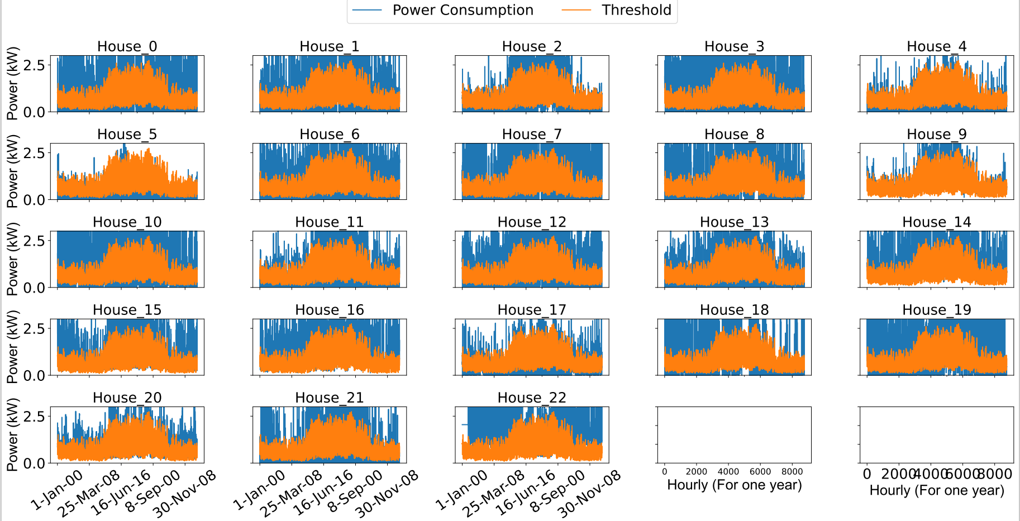
Results & Interesting Test Cases
Equal Distribution - Austin
Interesting cases- Houses 5 is able to fulfill the power demands for most of the time followed by House 4 and House 9 with allocated threshold. For rest of the Houses we can see the power demand is more than threshold allocated.

Slide 21
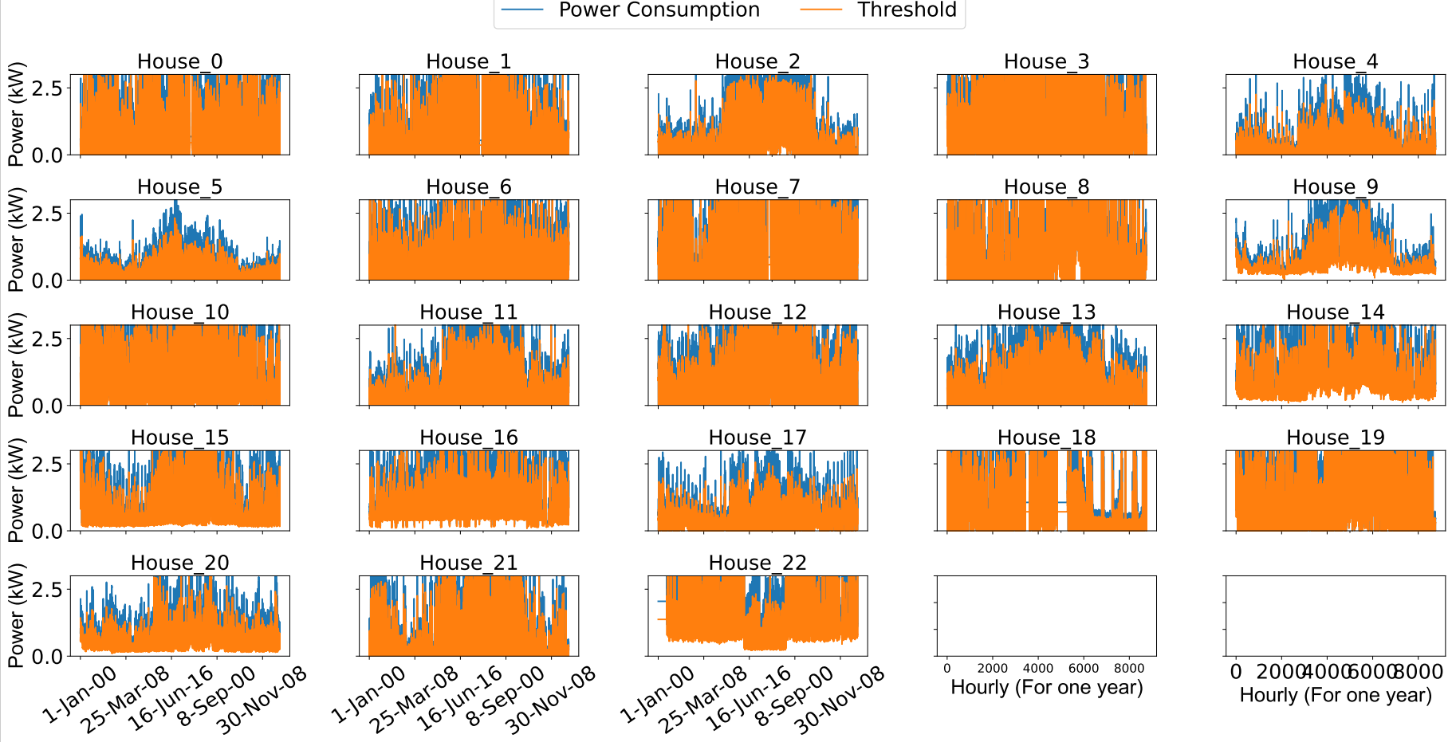
Proportionate Distribution
Austin
Interesting cases- In this neighborhood Houses 3, 7, 8, 10, 18, 19, 21, 22 have their power demands fulfilled by the allocated threshold for the rest of Houses too it seems better than Equal Distribution .

Slide 22
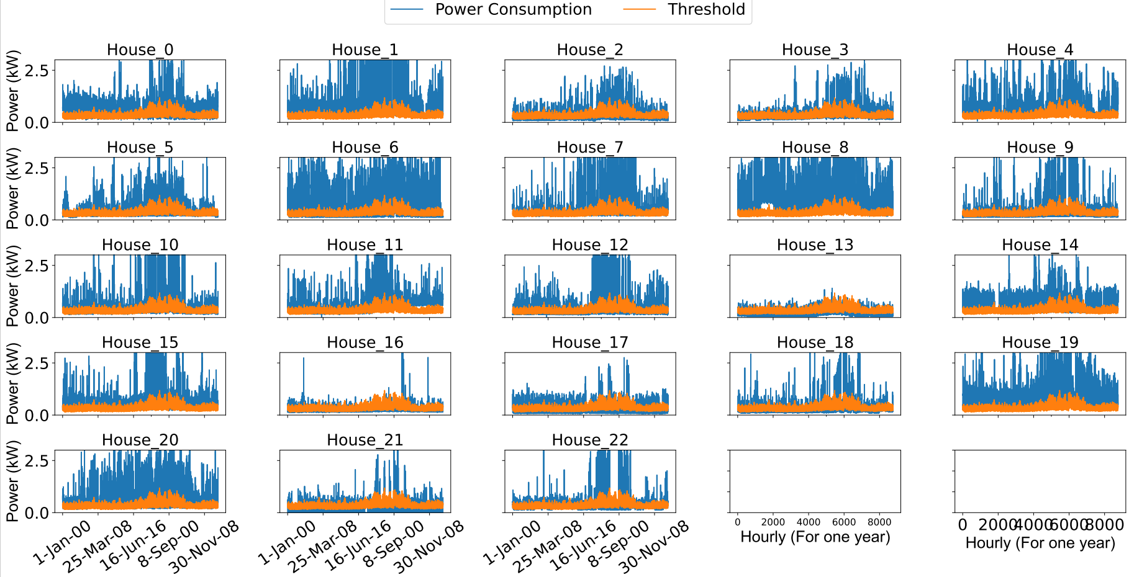
Equal Distribution - California
Interesting cases- Only House 13 followed by 16 are able to fulfill power demands with their allocated threshold while others are not able to do so.

Slide 23
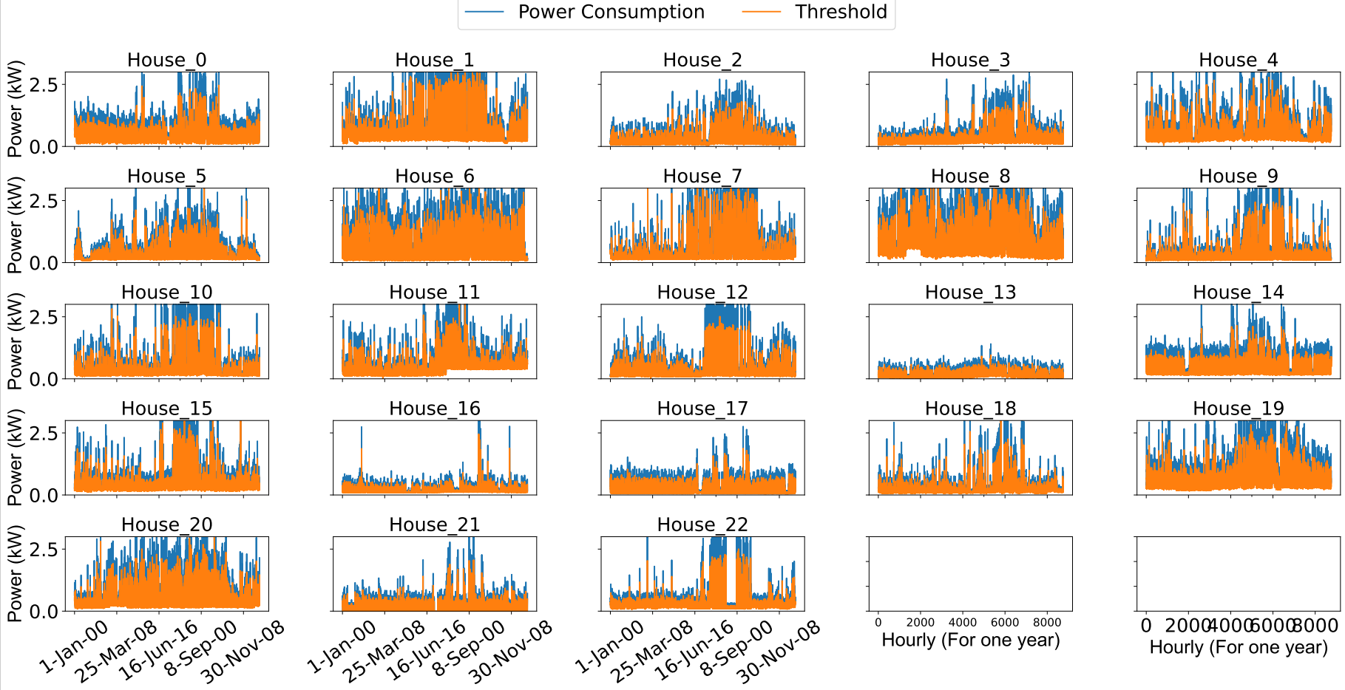
Proportionate Distribution
California
Interesting cases- In this neighborhood none of the House fulfill their power demand.

Slide 24
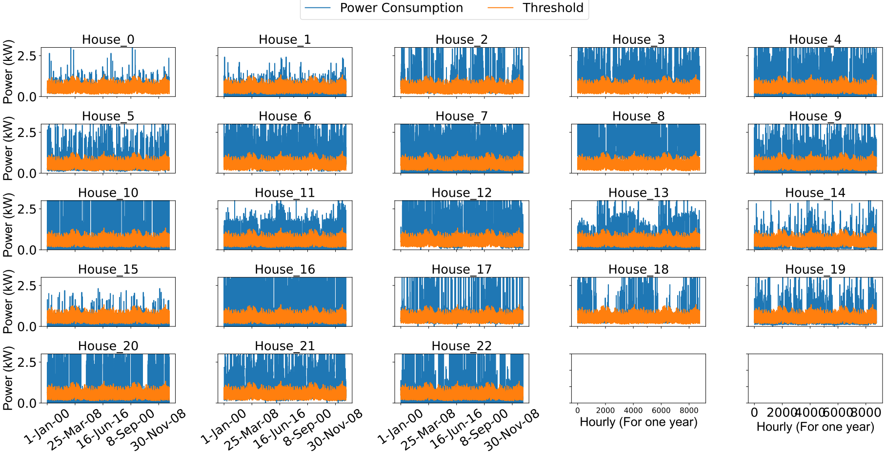
Equal Distribution – New York
Interesting cases- In this neighborhood none of the House other than House 0 and House 1 seems even close to fulfill the power demands of other Houses with the allocated threshold by the algorithm.

Slide 25
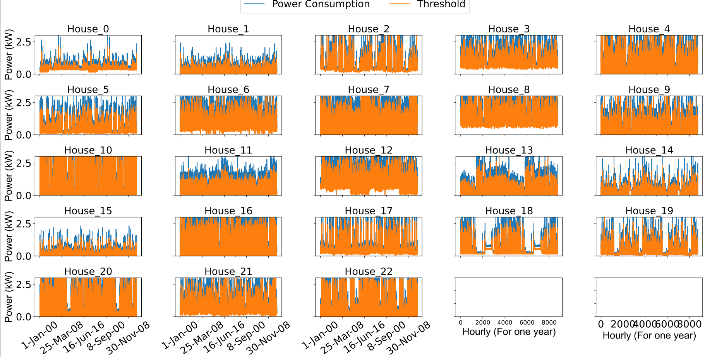
Proportionate Distribution
New York
Interesting cases- In this neighborhood House 10 followed by 16 and 20 and fulfill their power demand from their allocated threshold. And it seems better than Equal distribution.

Slide 26
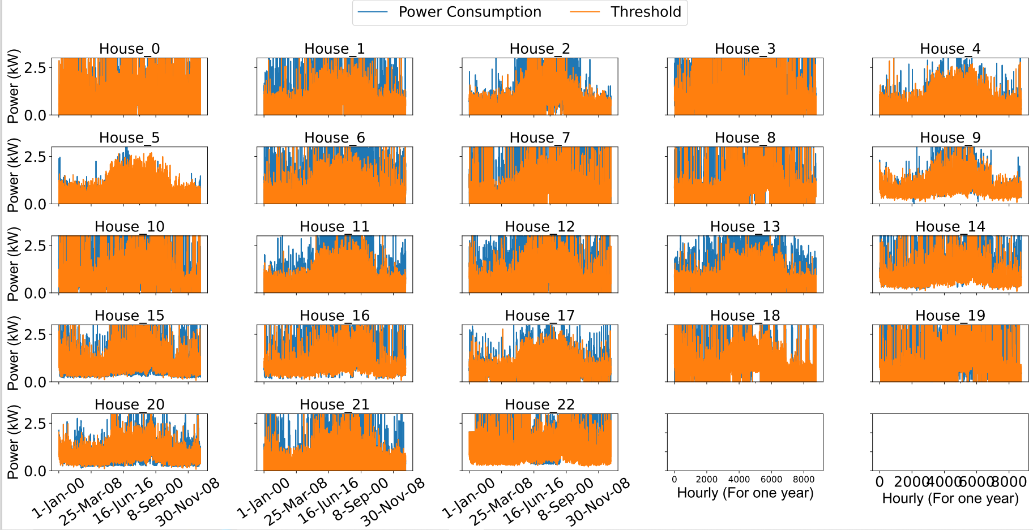
Round Robin Equal Distribution
Austin
Interesting cases- In this neighborhood Houses 0, 3, 5, 8, 10, 14, 18, 19, 20 are able to fulfill their power demand for a longer time from their allocated threshold. And others House are also able to do it but for a lower time.

Slide 27
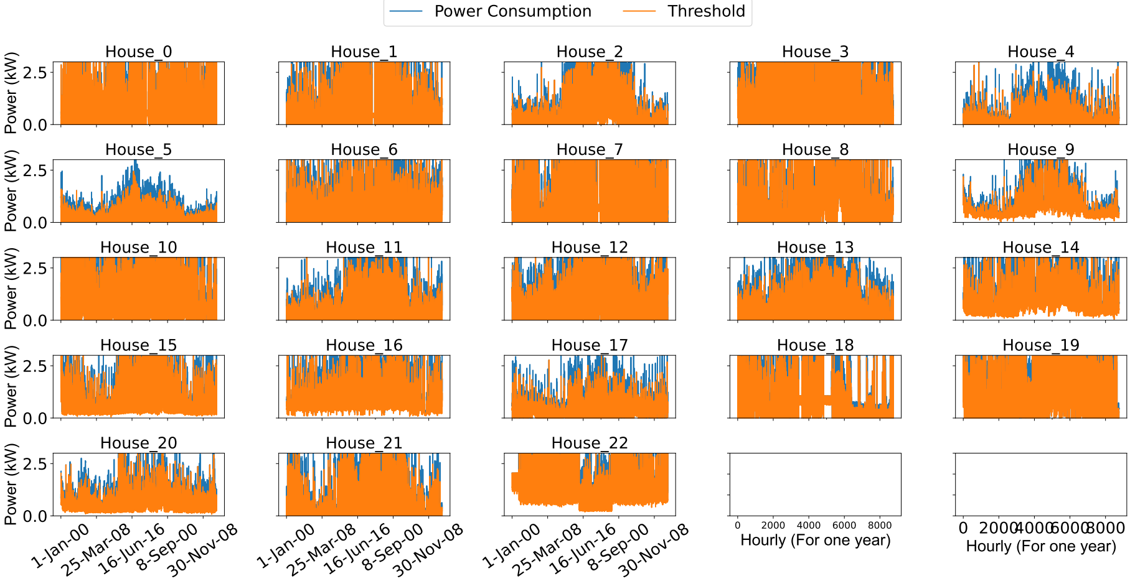
Round Robin Proportionate Distribution
Austin
Interesting cases- In this neighborhood most of the Houses fulfill their power needs from threshold allocated for a longer duration than in Round Robin Equal Distribution other than Houses 4, 5, 11, 12, 13 and 17.

Slide 28
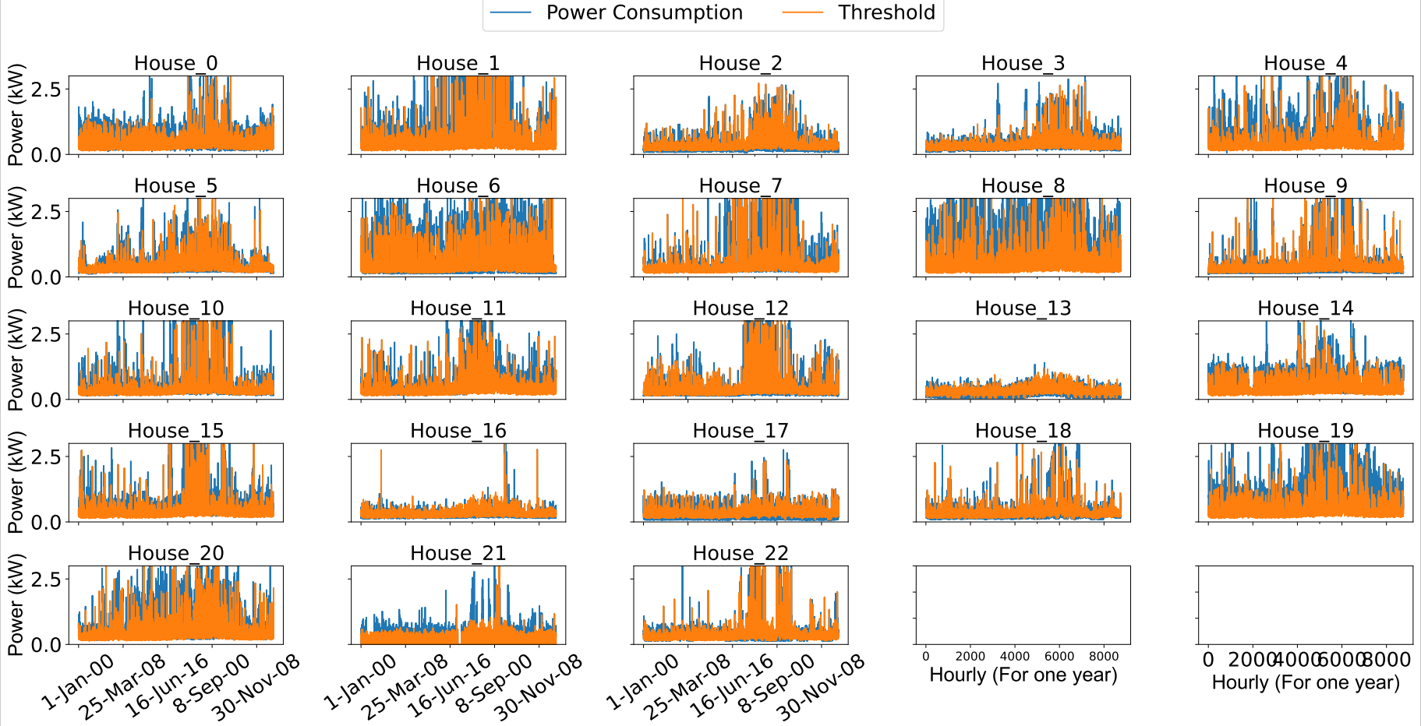
Round Robin Equal Distribution
California
Interesting cases- In this neighborhood most of the Houses are able to fulfill their power needs from threshold allocated but not all the time other than House 0, 4, 6, 8 19 and 20.

Slide 29
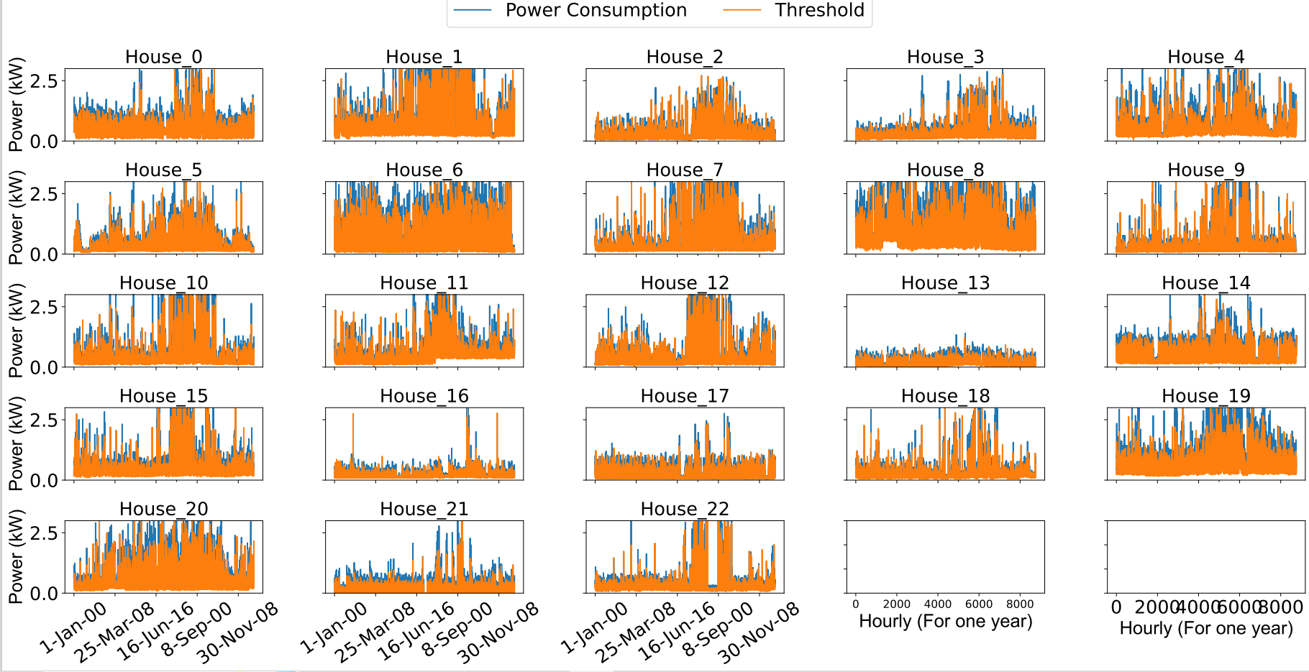
Round Robin Proportionate Distribution
California
Interesting cases- Interesting cases- In this neighborhood most of the Houses fulfill their power needs from threshold allocated for a longer duration than in Round Robin Equal Distribution other than Houses 1 , 6, 8, 13 and 19.

Slide 30
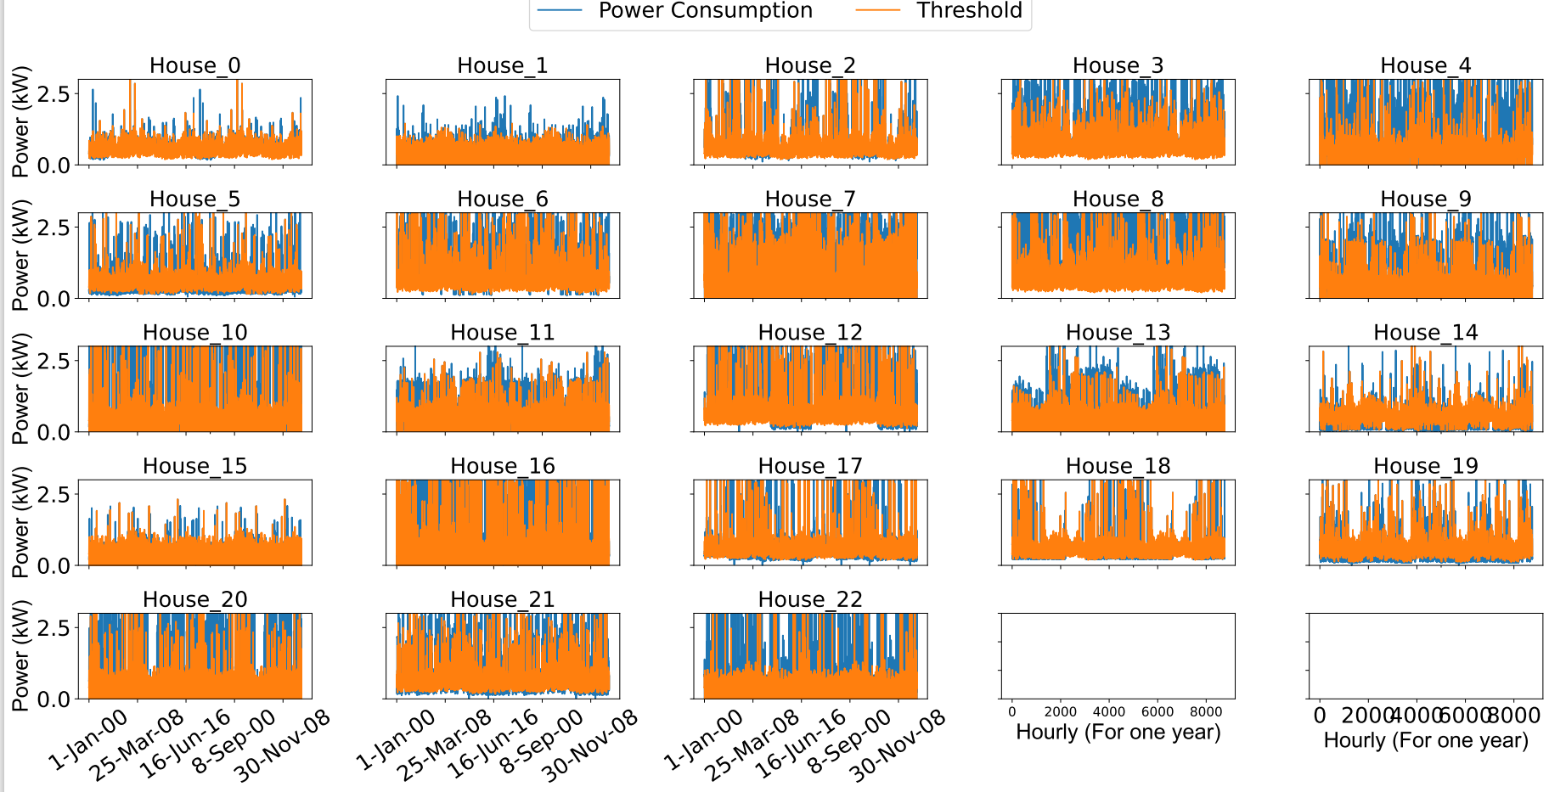
Round Robin Equal Distribution
New York
Interesting cases- In this neighborhood most of the Houses fulfill their power needs from threshold allocated for a shorter duration other than House 1, 9 and 22.

Slide 31

Round Robin Proportionate Distribution
New York
Interesting cases- In this neighborhood Houses are able to fulfill their power demands for a longer duration than in case of House 3, 4, 8, 13, w20 and 22.

Slide 32
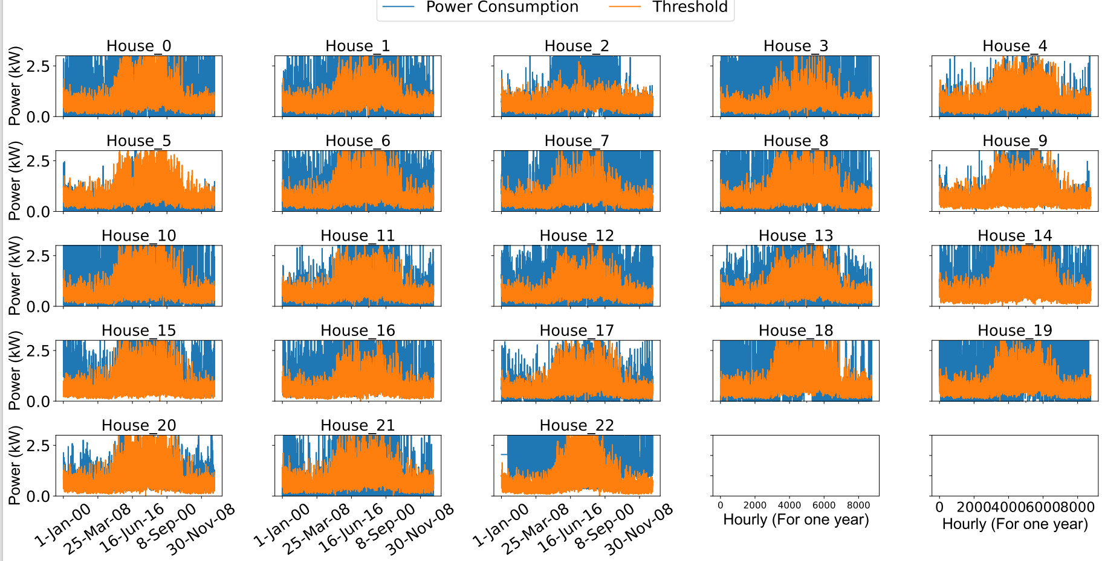
Consumer Usage Distribution
Austin
Interesting cases- In this neighborhood in case of House 2, 4 and 5 we can see that low power threshold is allocated when power demand is high and more power is allocated when the power demand is low.

Slide 33
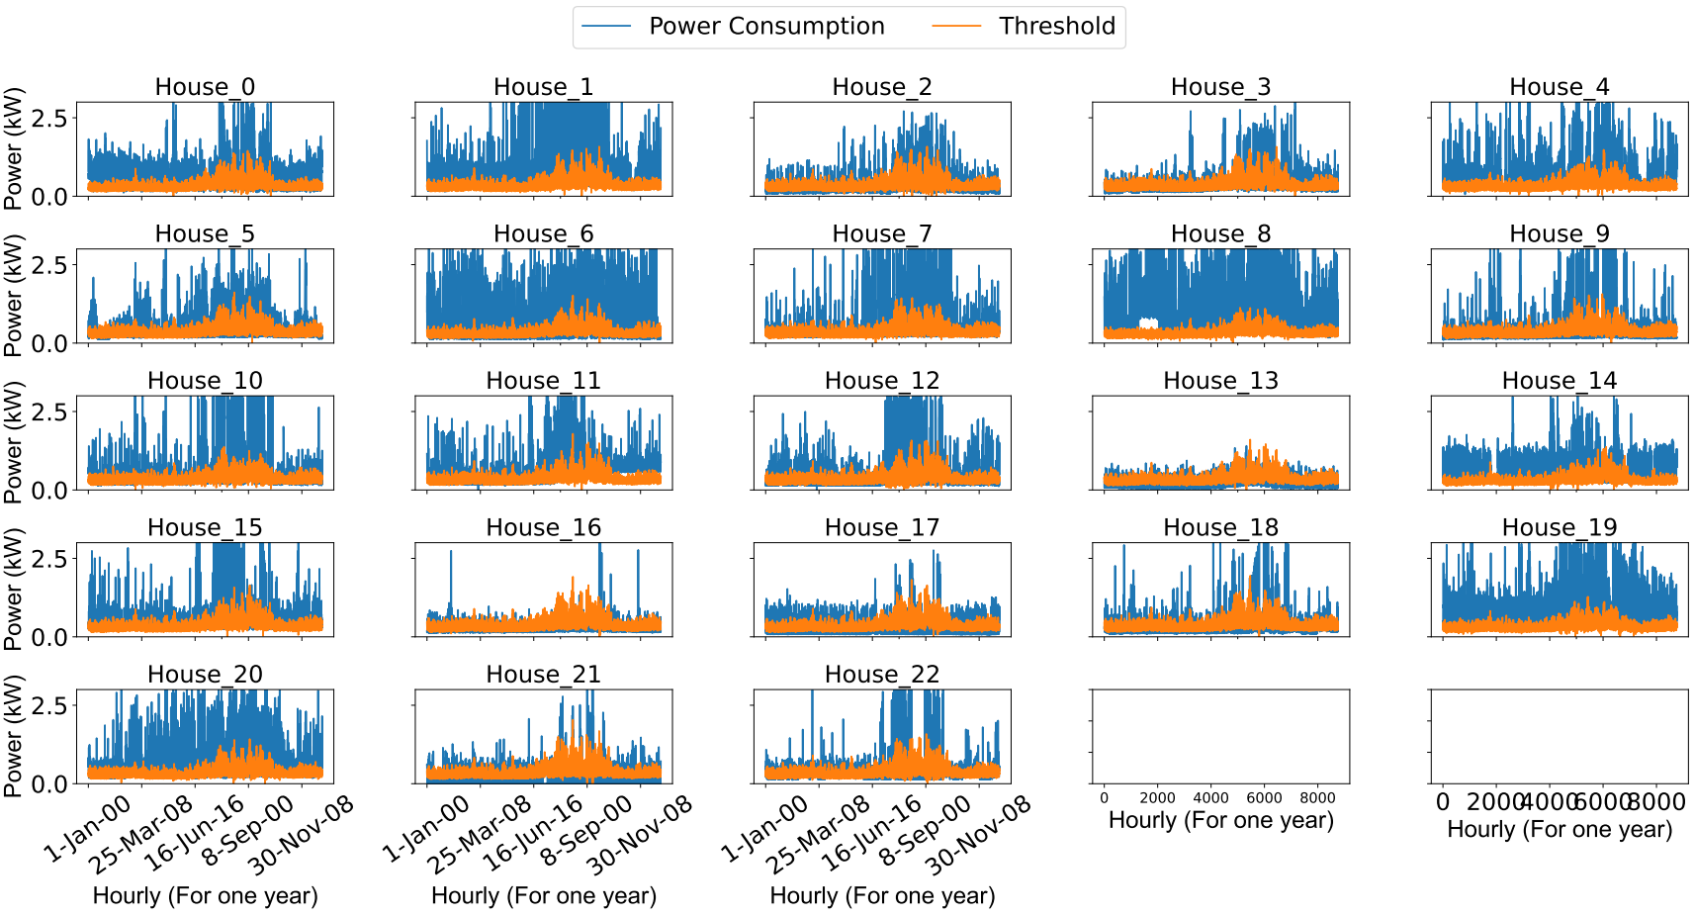
Consumer Usage Distribution
California
Interesting cases- In this neighborhood in case most of the Houses we can see that low power threshold is allocated when power demand is high and more power is allocated in House 13 and 16 when the power demand is low.

Slide 34
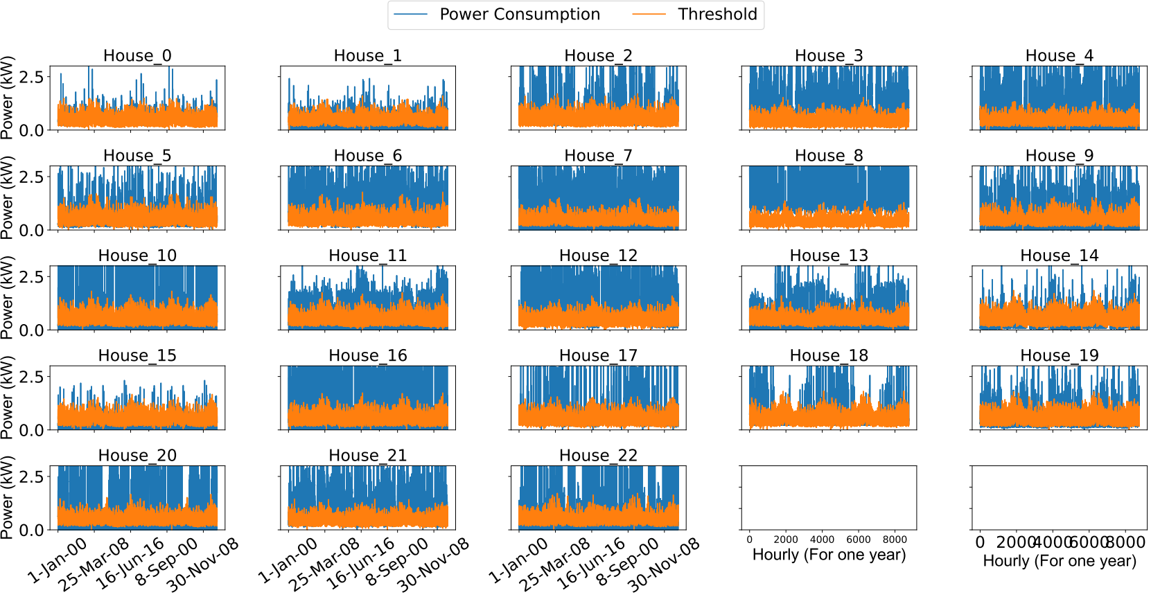
Consumer Usage Distribution
New York
Interesting cases- In this neighborhood in case most of the Houses we can see that low power threshold is allocated when power demand is high and more power is allocated in House 0, 1 and 15 when the power demand is low.

Slide 35
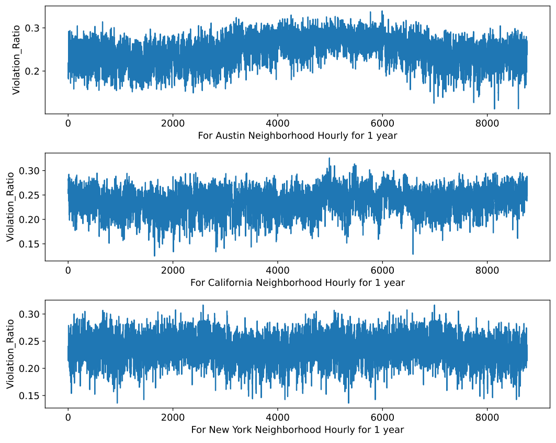
Violation for Equal Distribution

Slide 36
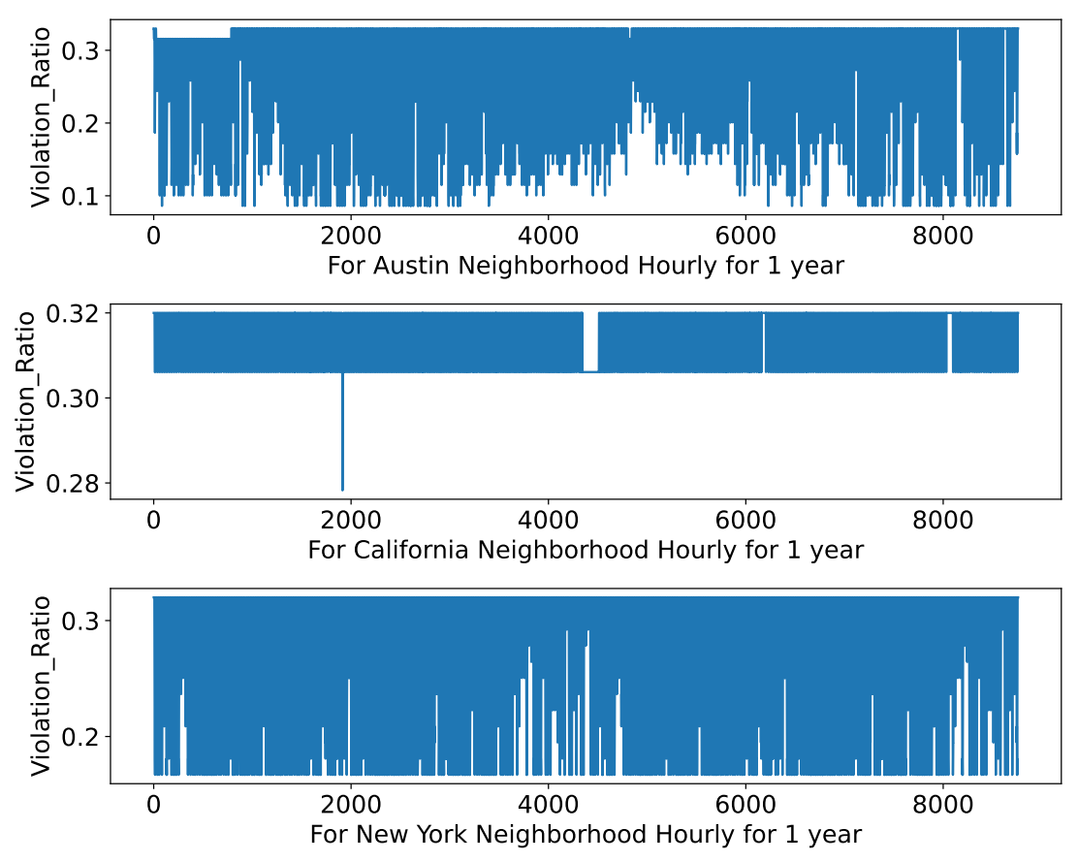
Violation for Proportionate Distribution

Slide 37
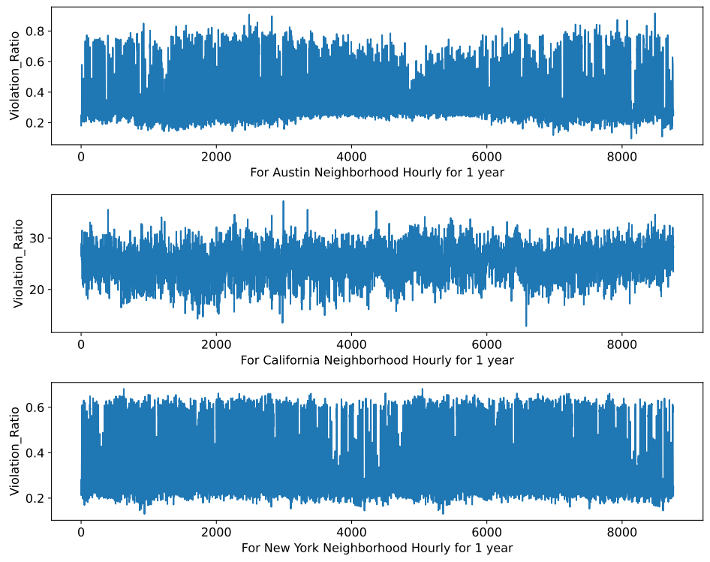
Violation for Round Robin Equal Distribution

Slide 38
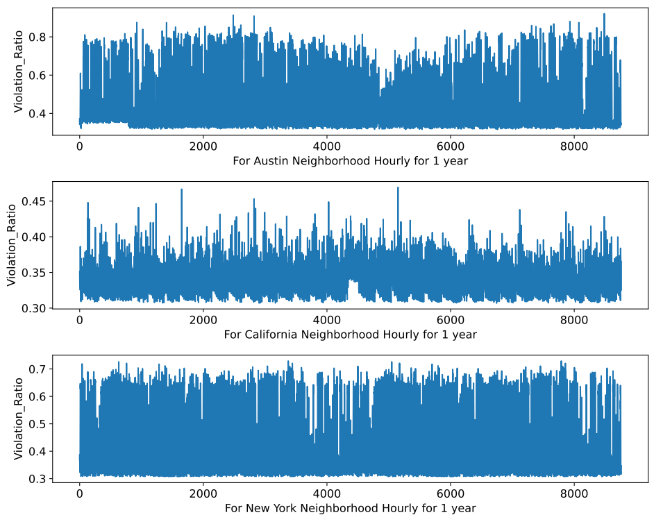
Violation for Round Robin Proportionate Distribution

Slide 39
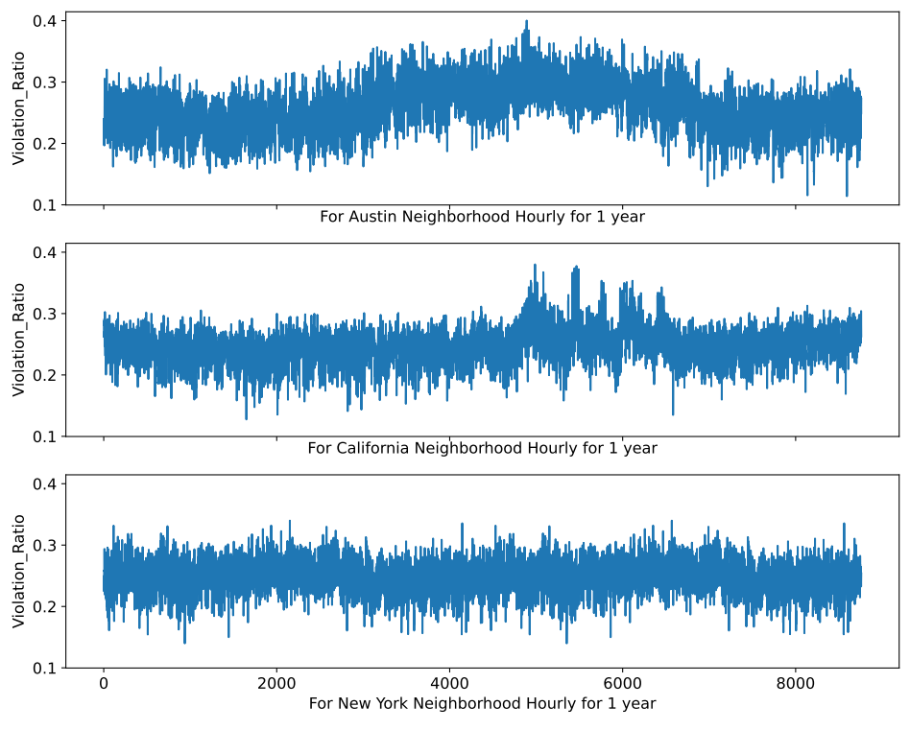
Violation for Consumer Usage Distribution

Slide 40
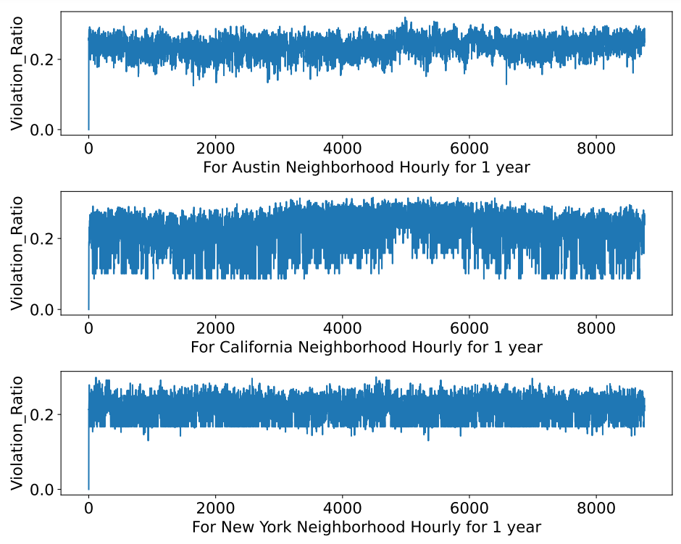
Violation for Hybrid Distribution

Slide 41
Conclusion & Future Scope

Slide 42
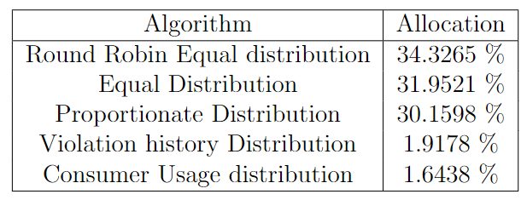
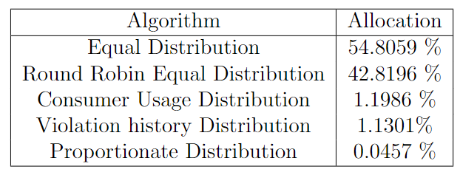
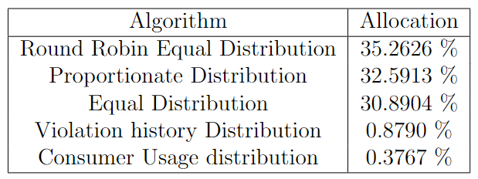
Percentage of Different Algorithms used by each Neighborhood in Hybrid Distribution
Austin
California
New York

Slide 43
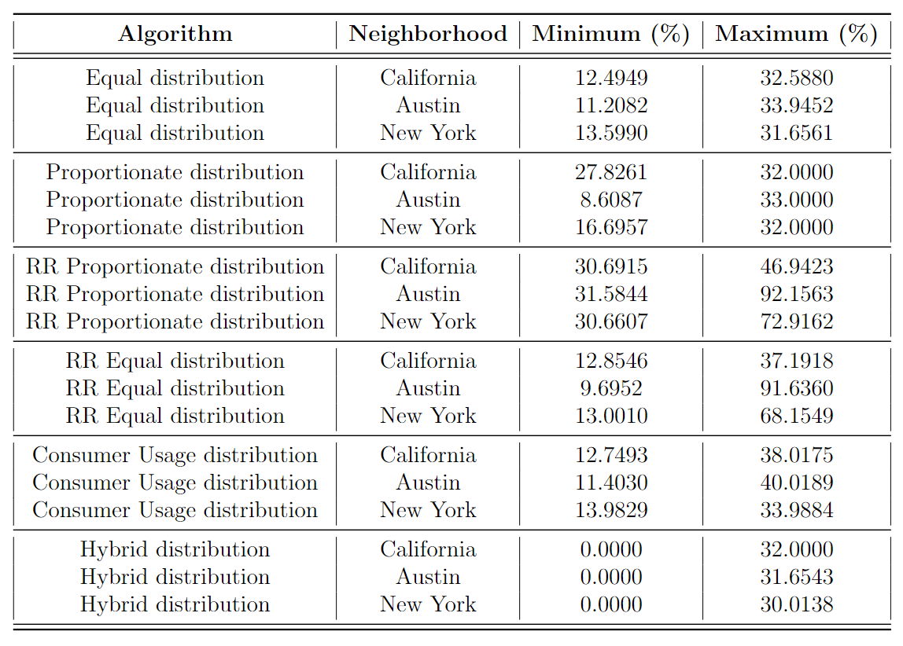
The following table describes the Violation % shown by each Algorithm by each Neighborhood.

Slide 44
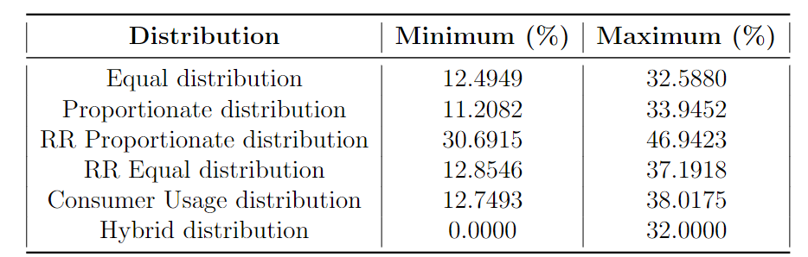
The overall violation is shown below

Slide 45
Future Scope
Advancement of smart grid technologies, such as smart meters, sensors, and automation, can enable real-time monitoring and precise implementation of brownouts.
Nuclear energy is one of the most cleanest energy we can invest in that as a renewable energy.
Biogas and Geo-thermal energy are also one of the most renewable energy.
The future scope of brownout management will depend on technological advancements, policies, and regional grid characteristics, but these areas provide a foundation for further development.
Incorporating renewable resources of energy like incorporating solar panels or wind turbines can help reduce peak load.

Slide 46
References
[1] International Energy Agency, “Global Energy Review 2021 - Electricity,” https://www. iea.org/reports/global-energy-review-2021/electricity, 2021.
[2] International Energy agency, “Global EV Outlook 2021,” https://www.iea.org/reports/ global-ev-outlook-2021, 2021.
[3] Ministry of Power, Government of India, “Power Sector at a Glance - All India,” https: //powermin.gov.in/en/content/power-sector-glance-all-india, 2023.
[4] K. Gaur, H. Kumar, R. P. K. Agarwal, K. V. S. Baba, and S. K. Soonee, “Analysing the electricity demand pattern,” in 2016 National Power Systems Conference (NPSC), 2016, pp. 1–6.
[5] Y. Guo, Y. Gong, Y. Fang, P. P. Khargonekar, and X. Geng, “Energy and network aware workload management for sustainable data centers with thermal storage,” IEEE Transactions on Parallel and Distributed Systems, vol. 25, no. 8, pp. 2030–2042, 2014.
[6] H. Sadeghian and Z. Wang, “Decentralized demand side management with rooftop pv in residential distribution network,” in 2018 IEEE Power & Energy Society Innovative Smart Grid Technologies Conference (ISGT), 2018, pp. 1–5.

Slide 47
[7] W. Saad, Z. Han, H. V. Poor, and T. Ba ̧sar, “Game theoretic methods for the smart grid,” ArXiv, vol. abs/1202.0452, 2012.
[8] S. Biswas, “Development of microcontroller based smart grid framework,” vol. 4, pp. 315–324, 08 2021.
[9] M. Xu and R. Buyya, “Energy efficient scheduling of application components via brownout and approximate markov decision process,” in Service-Oriented Computing, M. Maximilien, A. Vallecillo, J. Wang, and M. Oriol, Eds. Cham: Springer Interna- tional Publishing, 2017, pp. 206–220.
[10] D. Tran and A. Khambadkone, “Energy management for lifetime extension of energy storage system in micro-grid applications,” Smart Grid, IEEE Transactions on, vol. 4, pp. 1289–1296, 09 2013.
[11] J. Pan, B. Xu, X. Hou, L. Kou, and X. Qu, “Energy storage system planning based on cost analysis in distribution network,” in 2018 2nd IEEE Conference on Energy Internet and Energy System Integration (EI2), 2018, pp. 1–5.
[12] V. Calderaro, V. Coppola, V. Galdi, and P. Siano, “Assessing control and management issues for micro wind generation integration into microgrids,” 06 2008, pp. 750–755.

Slide 48
[13] M. Uddin, M. F. Romlie, M. F. Abdullah, S. Abd Halim, A. H. Abu Bakar, and T. Chia Kwang, “A review on peak load shaving strategies,” Renewable and Sustainable Energy Reviews, vol. 82, pp. 3323–3332, 2018. [Online]. Available: https://www.sciencedirect.com/science/article/pii/S1364032117314272
14] Z. Taylor, H. Akhavan-Hejazi, E. Cortez, L. Alvarez, S. Ula, M. Barth, and H. Mohsenian-Rad, “Customer-side scada-assisted large battery operation optimization for distribution feeder peak load shaving,” IEEE Transactions on Smart Grid, vol. 10, no. 1, pp. 992–1004, 2019.
[15] S. Nykamp, M. G. C. Bosman, A. Molderink, J. L. Hurink, and G. J. M. Smit, “Value of storage in distribution grids—competition or cooperation of stakeholders?” IEEE Transactions on Smart Grid, vol. 4, no. 3, pp. 1361–1370, 2013.
[16] S. Son and H. Song, “Real-time peak shaving algorithm using fuzzy wind power gen- eration curves for large-scale battery energy storage systems,” International Journal of Fuzzy Logic and Intelligent Systems, vol. 14, no. 4, pp. 305–312, Dec. 2014.
[17] M. Zheng, C. J. Meinrenken, and K. S. Lackner, “Smart households: Dispatch strategies and economic analysis of distributed energy storage for residential peak shaving,” Applied Energy, vol. 147, no. C, pp. 246–257, 2015. [Online]. Available: https://ideas.repec.org/a/eee/appene/v147y2015icp246-257.html

Slide 49
[18] B. Zhou, D. Xu, K. W. Chan, C. B. Li, Y. J. Cao, and S. Q. Bu, “A two-stage framework for multiobjective energy management in distribution networks with a high penetration of wind energy,” Energy, vol. 135, 2017.
[19] E. Reihani, M. Motalleb, R. Ghorbani, and L. Saad Saoud, “Load peak shaving and power smoothing of a distribution grid with high renewable energy penetration,” Renewable Energy, vol. 86, no. C, pp. 1372–1379, 2016. [Online]. Available: https://ideas.repec.org/a/eee/renene/v86y2016icp1372-1379.html
[20] Y. Guo and Z. Wang, “On peak shaving and load shifting in distribution systems: Cost saving vs peak load reduction,” in 2021 IEEE Power & Energy Society General Meeting (PESGM), 2021, pp. 1–5.
[21] R. Premkumar, R. Shanmugasundaram, K. R. Thilak, and A. N. V. S. S. Balaji, “A review on demand side management: Definition, scope, challenges and benefits,” in 2022 8th International Conference on Smart Structures and Systems (ICSSS), 2022, pp. 1–4.
[22] H. L. Willis, G. V. Welch, and R. R. Schrieber, Aging Power Delivery Infrastructures. New York: M. Dekker, 2001.
[23] A. Waltham, “Smart grid abstract: ”what are the benefits of smart grid?”,” in 2012 IEEE PES Innovative Smart Grid Technologies (ISGT), 2012, pp. 1–1.

Slide 50
[24] P. Yeung and M. Jung, “Improving electric reliability with smart meters,” White Paper, Silver Spring Networks, Silver Spring, 2013.
[25] A. Arif, M. Al-Hussain, N. Al-Mutairi, E. Al-Ammar, Y. Khan, and N. Malik, “Experi- mental study and design of smart energy meter for the smart grid,” in 2013 International Renewable and Sustainable Energy Conference (IRSEC), 2013, pp. 515–520.
[26] “Smart Grid Smart City Project (SGSCP) Grid Applications Stream: Fault Detection Isolation and Restoration Monitoring and Measurement Report Report III,” Technical Report, 2012.
[27] H. Tram, “Technical and operation considerations in using smart metering for outage management,” in 2008 IEEE/PES Transmission and Distribution Conference and Ex- position, 2008, pp. 1–3.
[28] S. V. Sreedevi, P. Prasannan, K. Jiju, and I. J. Indu Lekshmi, “Development of indige- nous smart energy meter adhering indian standards for smart grid,” in 2020 IEEE In- ternational Conference on Power Electronics, Smart Grid and Renewable Energy (PES- GRE2020), 2020, pp. 1–5.
[29] N. Sharma, A. Acharya, I. Jacob, S. Yamujala, V. Gupta, and R. Bhakar, “Major blackouts of the decade: Underlying causes, recommendations and arising challenges,” in 2021 9th IEEE International Conference on Power Systems (ICPS), 2021, pp. 1–6.

Slide 51
[30] M. Parihar and M. Bhaskar, “Review of power system blackout,” International Journal of Research and Innovation in Applied Science, vol. 3, pp. 8–12, 08 2018.
[31] B. D. Raj, S. Kumar, S. Padhi, A. Sarkar, A. Mondal, and K. Ramamritham, “Brownout based blackout avoidance strategies in smart grids,” IEEE Transactions on Sustainable Computing, vol. 6, no. 4, pp. 586–598, 2021.
[32] A. Agarwal and K. Khandeparkar, “Distributing power limits: Mitigating blackout through brownout,” Sustainable Energy, Grids and Networks, vol. 26, p. 100451, 2021. [Online]. Available: https://www.sciencedirect.com/science/article/pii/ S2352467721000229
[33] “Pecan street dataport.” [Online]. Available: https://www.pecanstreet.org/dataport/

